Slide 3
GMAS Practice Tests and Sample Questions | GMAS Test (lumoslearning.com)

Slide 4
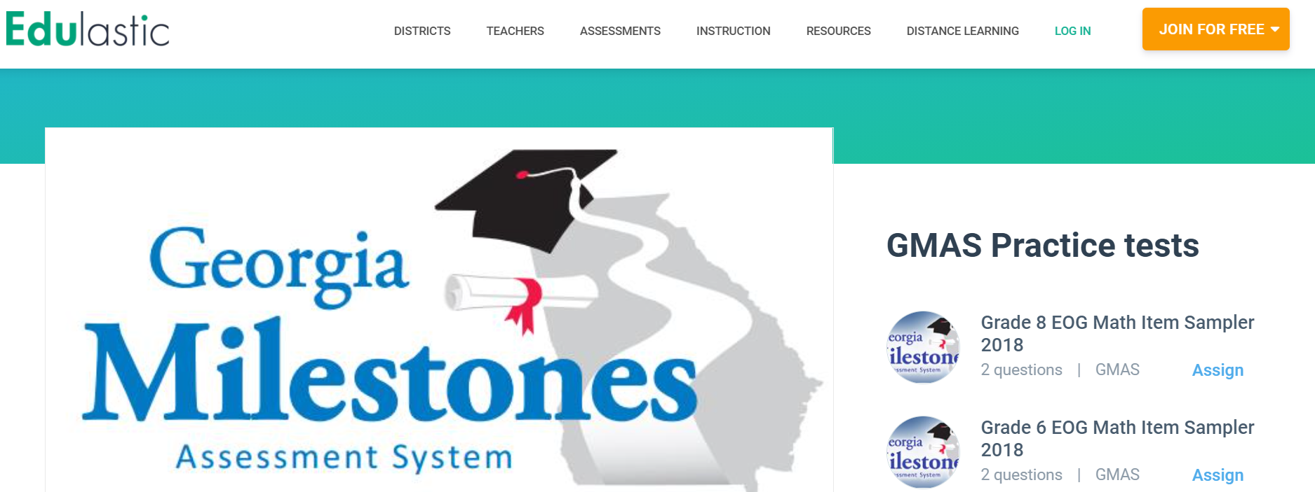
Free Online GMAS Practice Tests and Tips for Georgia Milestones Success | Edulastic

Slide 5
Blueprint / GMAS Weights
https://www.gadoe.org/Curriculum-Instruction-and-Assessment/Assessment/Documents/Milestones/Blueprints/GA_EOG_Grade_3_Blueprint_July_2020.pdf 3rd grade
https://www.gadoe.org/Curriculum-Instruction-and-Assessment/Assessment/Documents/Milestones/Blueprints/GA_EOG_Grade_4_Blueprint_July_2020.pdf 4th grade
https://www.gadoe.org/Curriculum-Instruction-and-Assessment/Assessment/Documents/Milestones/Blueprints/GA_EOG_Grade_5_Blueprint_July_2020.pdf 5th grade

Slide 6
Practice Online http://www.gaexperienceonline.com/
http://www.gaexperienceonline.com/
• Click Test Practice
• Online Training Tools
• EOG Test Practice, Standard Online Tools
• Grades 3-5
• Type Username & password that is on screen, click sign in
• Click Continue
• Grades 3-5 Test Practice
• Follow prompts

Slide 7
GADOE Resources
GMAS Assessment Guide
https://www.gadoe.org/Curriculum-Instruction-and-Assessment/Assessment/Pages/Georgia-Milestones-End-of-Grade-Assessment-Guides.aspx
Reading & Evidence Based Writing Sampler (Item Scoring Sampler)
https://www.gadoe.org/Curriculum-Instruction-and-Assessment/Assessment/Pages/Item-Samplers.aspx

Slide 8
Professional Learning GADOE
​​​​​​​​​​​​​​
This series of professional learning resources is designed to foster a deeper understanding of assessment in the state of Georgia.
https://www.gadoe.org/Curriculum-Instruction-and-Assessment/Assessment/Pages/Professional_Learning.aspx
Georgia Milestones Assessment System:
Evaluating and Improving Student Writing
Helpful 1 hour PL sessions for writing - GaDOE Assessment Div Writing PL

Slide 9
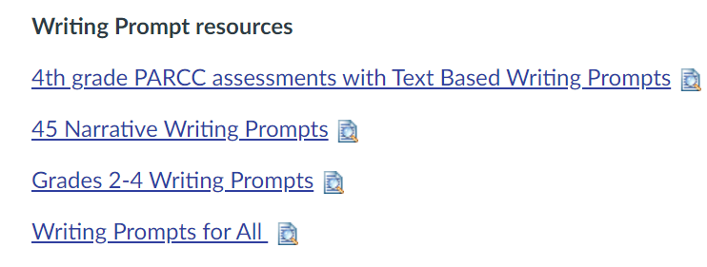
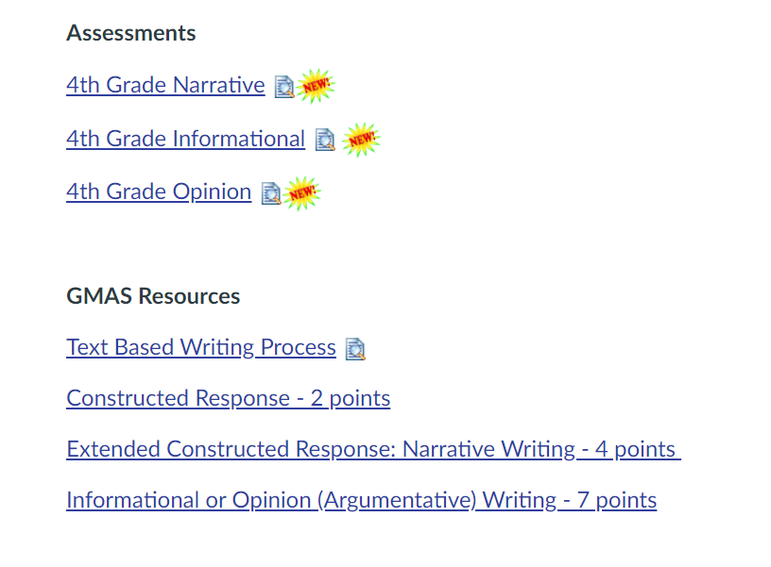
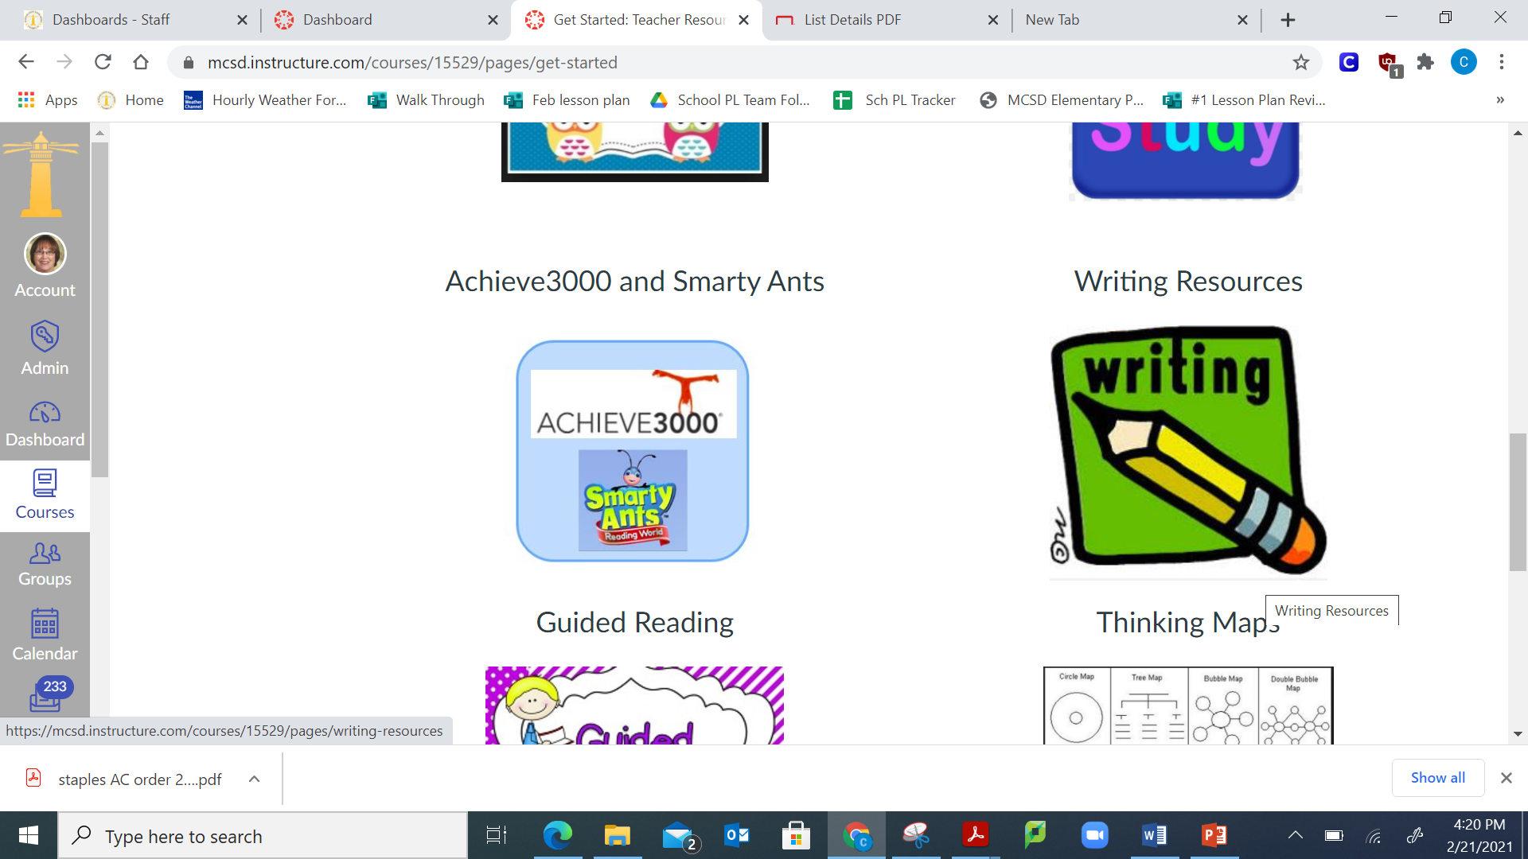
Canvas

Slide 10
Think Aloud
I know you do this already, but just as a reminder be sure you think aloud and do these writing prompts as class assignments as a whole group or for small groups, so your students will see the thinking and process in action.

Slide 11
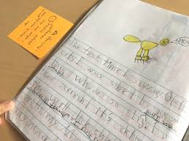
Conferring / Writing Conference
One on one
Small group
Sticky notes
Kami/Google Docs write a note on individual student’s writing
Audio recording of an idea to support writing

Slide 12
What are strategies that support writing development?
Recipe
Anchor Chart
Model + Think Aloud
Mini Lessons
Students Write
Confer

