Slide 1
Georgia Milestones State Testing
(Elementary/Middle)

Slide 2
Purpose of the Georgia Milestones
Provides information on how well students are mastering
state standards
Provide students information about their own learning
and readiness
Provide Parents information about their child’s learning
and progress
Provide information that will assist in improving
school effectiveness
Georgia Milestones

Slide 3
Georgia Milestones
Grades 3 – 8 End of Grade (EOG)
Language arts
Mathematics
Science
Social studies

Slide 4
What is the Georgia Milestones?
Comprehensive, Coherent, Consolidated
formative assessment tool to compliment summative assessments administered in classrooms
rigorous and aligned to Georgia Standards of Excellence
provides stakeholders with information regarding student preparedness for the next level
combines reading, language arts, and writing into a single measure

Slide 5
What is the goal of the Georgia Milestone Assessment System?
The ultimate goal of GMAS is to ensure all students have received high-quality instruction based on the content standards provided by the state which ensure students are able to meet high academic expectations.

Slide 6
Which students will take the GMAS?
Grades 3-8
End of Grade (EOG) in language arts, mathematics, science, social studies
All students will complete the assessment online.
Testing Window: April 6th – April 30th

Slide 7
What types of items will be on the GMAS?
Item Types
Selected-Response (AKA multiple-choice)
all content areas
evidence-based selected response in ELA
Constructed-Response
ELA and mathematics
Extended-Response
ELA and mathematics
Technology Enhanced

Slide 8
Examining Georgia Milestones Item Types
Mathematics
Georgia Milestones

Slide 9
Selected Response
Which fraction is largest?
A
B
C
D
The content and presentation of these items are for illustrative purposes only.
Notes:
Click to answer the item.
Click to transition to CR item.

Slide 10
Constructed Response
George and Ana each had a 12-inch pizza. Both pizzas were split into 8 equal pieces. The shaded pieces are the portion of their pizzas that George and Ana ate.
Express in fractions how much pizza George and Ana ate. Use the symbol <, =, or > to show who ate more pizza.
George Ana
George Ana
>
The content and presentation of these items are for illustrative purposes only.
Notes:
Click to answer the item.
Click to transition to CR item.

Slide 11
George
Ana
12 inches
9 inches
George
Carlos
12 inches
12 inches
The content and presentation of these items are for illustrative purposes only.
Notes:
Click to answer the item.
Click to transition to CR item.

Slide 12
Technology Enhanced
>
The content and presentation of these items are for illustrative purposes only.
Notes:
Click to answer the item.
Click to transition to CR item.

Slide 13
Examining Georgia Milestones Item Types
English Language Arts
Georgia Milestones

Slide 14
Selected-Response: 1 point
Which sentence from the movie review BEST supports the conclusion that filmmakers value dramatic stories over accurate ones?
As the movie begins, we learn that a group of cowboys has been traveling on a cattle trail for many days in the late winter.
B. The truth is that the life of a cowboy was much more dangerous and exhausting than the movie shows.
C. The next day, the cowboys in the movie get up and begin to prepare for the day ahead.
D. Cowboys sacrificed a great deal and often had to leave family behind.
Georgia Milestones

Slide 15
Constructed-Response 2 Points
How did the reviewer’s knowledge of the lives of real cowboys MOST LIKELY influence his or her opinion of the movie? Use details from the movie review to support your answer.
Georgia Milestones

Slide 16
Extended Constructed-Response: 4 points
Rewrite this part of the story using more descriptive details. Think about how Angela and Carlos felt, as well as what they saw, smelled, and heard.
Write your answer on the lines provided.
Georgia Milestones

Slide 17
Extended Writing-Response: 7 points
In this section, you will read two student passages. You will write an informational essay detailing the similarities and differences in how the schools are described in each passage. Before you begin planning and writing, you will read two passages. As you read the passages, think about what details from the passages you might use in your informational essay.
These are the titles of the passages you will read:
The Center
2. School Pride Day
Georgia Milestones

Slide 18
GMAS: 4 Levels of Performance
Designation | Progression of Learning
Beginning | Learners do not yet demonstrate proficiency in the knowledge and skills necessary at this grade level/course of learning, as specified in GA’s content standards. The students need substantial academic support to be prepared for the next grade level/course or to be on track for college and career readiness.
Developing | Learners demonstrate partial proficiency in the knowledge and skills necessary at this grade level/course of learning, as specified by GA’s content standards. Students need additional academic support to ensure success in the next grade level/course and to be on track for college and career readiness.
Proficient | Learners demonstrate proficiency in the knowledge skills necessary at this grade level/course of learning, as specified in GA’s content standards. The students are prepared for the next grade level/course and are on track for college and career readiness.
Distinguished | Learners demonstrate advanced proficiency in the knowledge and skills necessary at this grade level/course as specified by GA’s content standards. The students are well prepared for the next grade level/course and are well prepared for college and career readiness.

Slide 19
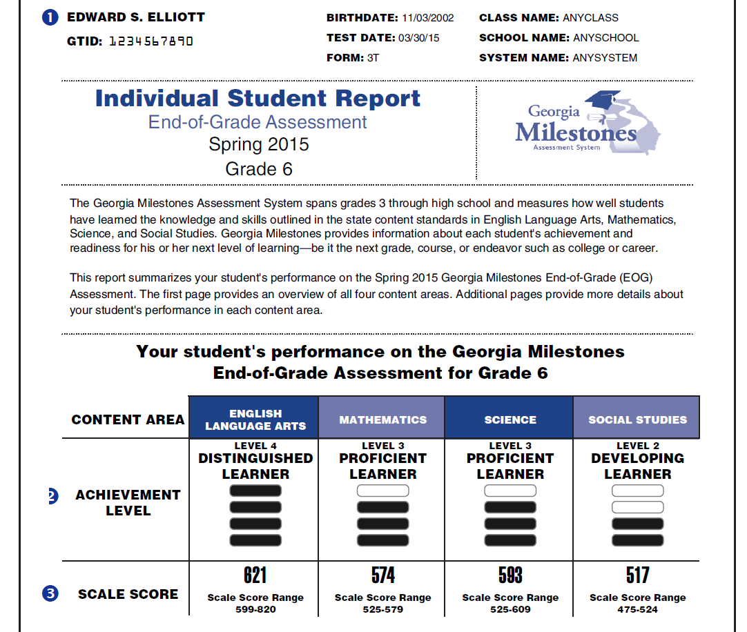
Student Score Reports
Page 1 of student score report contains:
- Achievement levels for each content area
-Scale score for each content area
Georgia Milestones

Slide 20
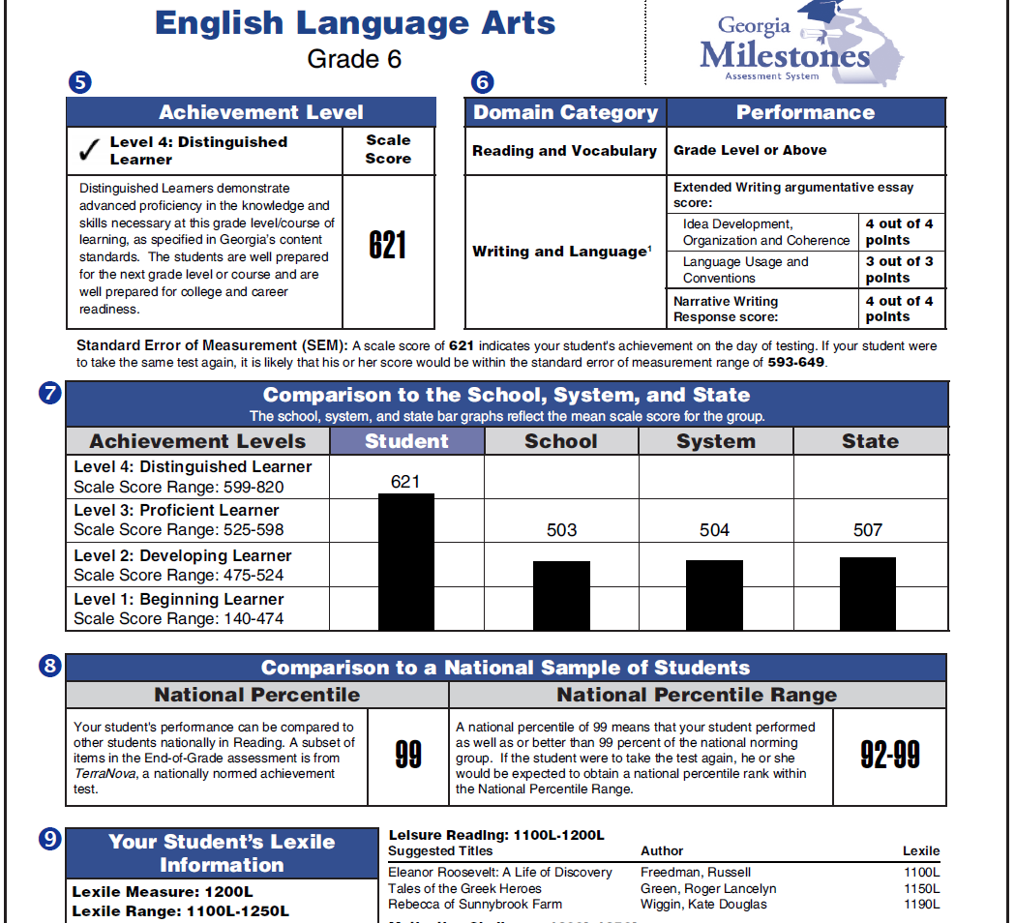
Page 3 (p.2 is blank) of student score report contains ELA:
5. Achievement level and score
6. Performance in Reading and Vocabulary and performance in Writing and Language
7. Achievement level in comparison to the school, system, and state
8. Comparison to a national sample of students
9. Reading Lexile information and suggested reading titles
Georgia Milestones

Slide 21
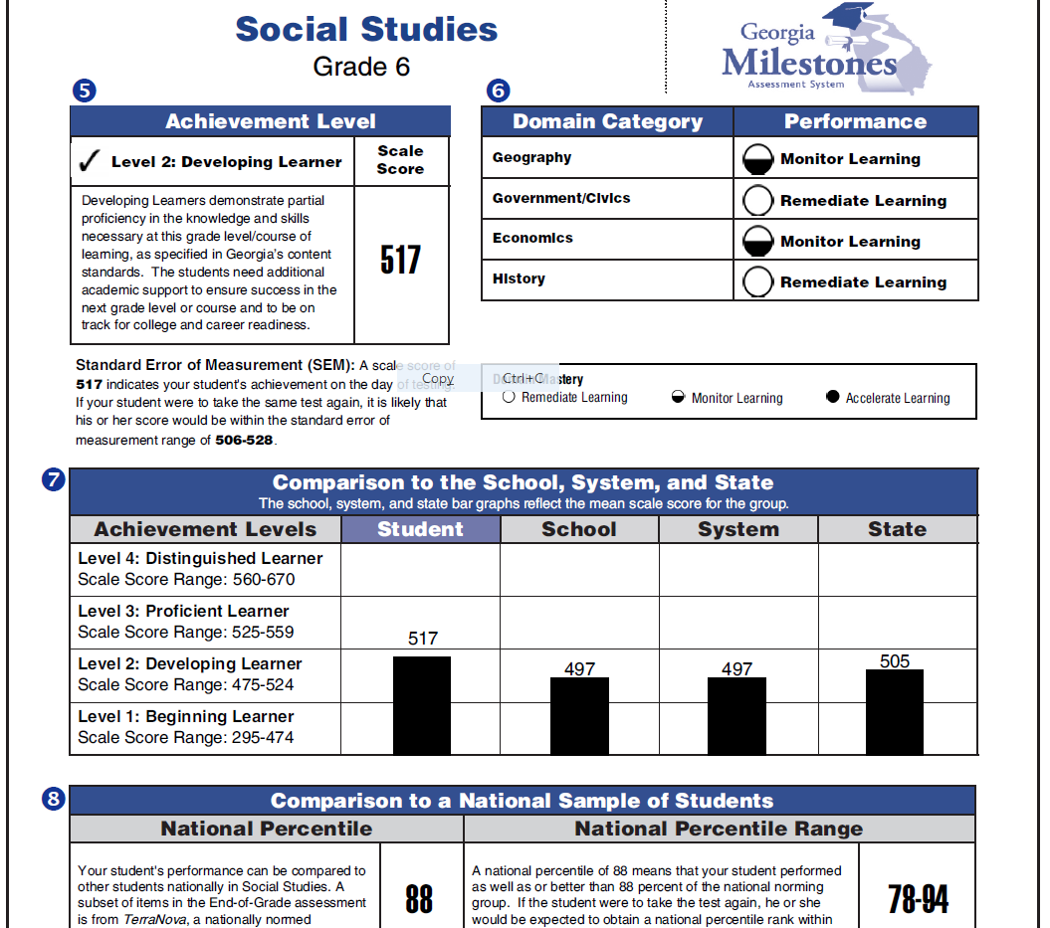
Student Sample Report Continued
Pages 4, 5, and 6 of student score report contains Math, Science and Social Studies:
5. Achievement level and score
6. Performance in content domains and recommendations for domain mastery: Remediate Learning, Monitor Learning, or Accelerate Learning
7. Achievement level in comparison to the school, system, and state
8. Comparison to a national sample of students
Georgia Milestones

Slide 22
Lexile Measures and GMAS
Lexile measures for students will also be provided on the student score reports. These measures link text complexity (how easy or difficult a piece of writing is to read) to the readers’ ability.
This measure will be used to determine promotion and retention for 3rd, 5th, and 8th grade students.

Slide 23
New Retention Guidelines
Promotion for 3rd grade: Students must have a Lexile of 520 or above in Reading on GMAS
Promotion for 5th grade: Students must have a Lexile of 830 or above in Reading on GMAS AND be developing or above in Math
Promotion for 8th grade: Students must have a Lexile of 1010 or above in Reading on GMAS AND be developing or above in Math

Slide 24
Second Chance to Pass the GMAS
The students will have one additional opportunity to retake the GMAS before the end of the school year, and it will be administered online.
After the retest of the GMAS, the school’s promotion and retention committee will meet to determine if the students are eligible to be promoted by other criteria that will be determined by the district.

Slide 25
What happens if my student does not pass the GMAS the second time?
If a student does not pass the GMAS the second time, he or she will be required to attend a district sponsored summer school session of approximately 4-6 weeks; if they do not attend summer school, they will NOT be promoted: this will override the promotion/retention committee’s recommendation.
Georgia Milestones

Slide 26
What can I do to help my child at home?
Encourage your child to employ good study and test-taking skills. These skills include following directions carefully, avoiding careless, avoiding careless errors, and reviewing work.
Explain the purpose of the test. The assessments give students the opportunity to show what they have learned in school. They also give teachers information that helps them plan lessons.
Georgia Milestones

Slide 27
What can I do to help my child at home?
Remind your child that some of the questions maybe harder than others, but don’t give up and do your best.
Be certain your child gets plenty of sleep and has a healthy breakfast and lunch. Taking tests is hard work for many students and can require a lot of energy.
Georgia Milestones

Slide 28
What can I do to help my child at home?
Be certain that your child is at school on time. Rushing and worrying about being late could affect your child’s performance on the tests.
Remember to ask your child about the testing at the end of each day.
Have your student READ…READ…READ… and…WRITE…WRITE…WRITE…
Georgia Milestones

Slide 29
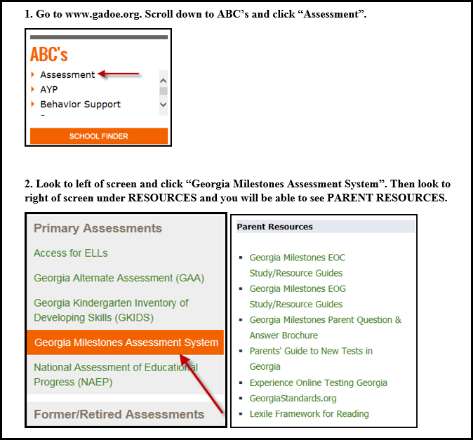
Accessing Georgia Milestones Parent Resources
Georgia Milestones

