Slide 1
Georgia Milestones Assessment System DIMON MAGNET ACADEMY

Slide 2
AGENDA
Video
What is Georgia Milestones Assessment
Who Takes Georgia Milestones Assessment
Parameters
Performance Levels
Types of Questions and Assessment Items
What You Can Do at Home
Resources Available

Slide 3
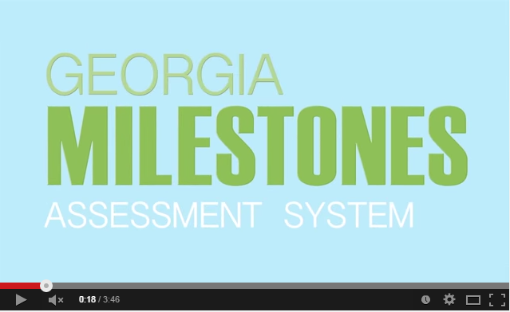
https://www.youtube.com/watch?v=vgtvKTbBP8E&feature=youtu.be

Slide 4
What is Georgia Milestones?
In 2014-2015, the Georgia Milestones Assessment System replaced the CRCT in Reading, ELA, Science, and Social Studies.
The Georgia Milestones Assessment System offers increased rigor in all content areas that later prepare students for the SAT.
* Depth of Knowledge Levels
* Resource Guide pg. 8-10

Slide 5
What is different about the new assessments?
Students will be asked not only what the answer is to a question, but why – i.e. how they know or what evidence supports their answer.
Open-ended items
(also known as constructed-response) asks students to provide both short answer and extended types of responses.

Slide 6
Who will take the Georgia Milestones?
Students in Grades 3-5 will take the Georgia Milestones End of Grade Assessment in April of 2017
Grade 3: Language Arts and Mathematics
Grade 4: Language Arts and Mathematics
Grade 5: Language Arts, Mathematics, Science, and Social Studies.
**Language Arts includes Reading, Writing, and Grammar**

Slide 7
General Test Parameters
ELA will consists of 3 sections, 1 of which will focus mainly on writing
Mathematics will consist of 2 sections
Science will consist of 2 sections
Social Studies will consist of 2 sections

Slide 8
Georgia Milestones performance levels
Beginning Learner
Developing Learner
Proficient Learner
Distinguished Learner

Slide 9
Types of Test Questions Students will Answer
1. Constructed Response in ELA and Mathematics
2. Selected Response items in all content areas
3. Evidence Based Selected Response in ELA
4. Extended Response in ELA and Mathematics
5. A writing component (based on text evidence) at every grade level
6. Technology Enhanced Items (NEW)

Slide 10
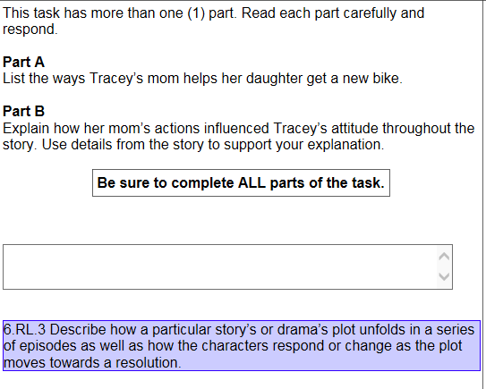
Reading/ELA – Assessment Item
Multiple-Parts
Text Dependent Questions
Deeper Understanding
Notes:
This sample item shows that the next generation of test items will have multiple parts. Students are required to show deeper understanding and use details directly from the story to support their explanations.

Slide 11
Mathematics – Assessment Item
Scaffolded
Constructed Response
Students explain their responses
Students show work
Notes:
Here is an example of a new item types. The items are scaffolded in that they have multiple parts with increased complexity. Students will need to both show and explain their work for Mathematics problems.

Slide 12
Multiple Choice
Which fraction is largest?
A
B
C
D
The content and presentation of these items are for illustrative purposes only.
Notes:
Click to answer the item.
Click to transition to CR item.

Slide 13
Constructed Response
George and Ana each had a 12-inch pizza. Both pizzas were split into 8 equal pieces. The shaded pieces are the portion of their pizzas that George and Ana ate.
Express in fractions how much pizza George and Ana ate. Use the symbol <, =, or > to show who ate more pizza.
George Ana
George Ana
>
The content and presentation of these items are for illustrative purposes only.
Notes:
Click to answer the item.
Click to transition to CR item.

Slide 14
Constructed Response
George
Ana
12 inches
9 inches
George
Carlos
12 inches
12 inches
The content and presentation of these items are for illustrative purposes only.
Notes:
Click to answer the item.
Click to transition to CR item.

Slide 15
Technology Enhanced
>
The content and presentation of these items are for illustrative purposes only.
Notes:
Click to answer the item.
Click to transition to CR item.

Slide 16
How are students prepared for Georgia milestones?
Reading Wonders
Achieve 3000
Envision Math
Social Studies Weekly
Georgia Performance Standards for Science

Slide 17
How Can You Prepare Your Children for Georgia milestones?

Slide 18
What can you do at home?
Before Test Day
Be Prepared
Help your child in areas that are difficult for him/her
Give your child a chance to practice
If you have concerns, talk with your child’s teacher
On Test Day
Make sure your child gets a good night sleep and eats a healthy breakfast
Make sure your child is prepared
Remain Positive
After Test Day
Review the test results with child

Slide 19
What You can do On a daily basis
Assisting your child with homework and ensuring that your child is completing all homework assignments
Helping him/her to develop good study habits, thinking skills, and a positive attitude towards education from an early age
Ensuring that your child has good attendance at school
Staying in communication with your child's teacher
Encouraging your child to read as much as possible, and to increase their vocabulary - even reading magazines, newspapers, and comic books regularly will help improve their reading skills
Looking for educational games and programs that engage your child
Helping your child learn how to follow directions carefully
Make sure your child arrives at school on time

Slide 20
What resources are available to help prepare your child for Georgia milestones?

Slide 21
Georgia Milestones Assessment System

Slide 22
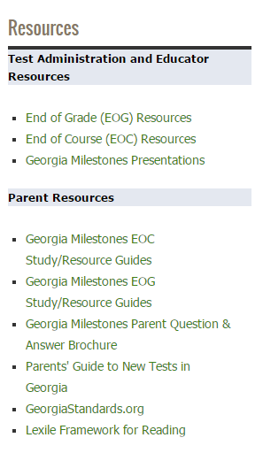
http://www.gadoe.org

Slide 23
Transition to Georgia Milestones: Resources Available NOW
EOG Study/Resource Guides (Gr 3-8)
Assessment Guides for Educators (and parents) provided to acquaint Georgia educators and other stakeholders with the structure and content assessed

Slide 24
Transition to Georgia Milestones: Resources Available NOW
Content Standards
Frameworks, Formative lessons, Partnership for Assessment of Readiness for College and Careers (PARCC) evidence statements (GeorgiaStandards.org)
Sample items
Formative items/benchmarks via Georgia OAS→GOFAR;
Released items via PARCC (https://parcc.pearson.com/practice-tests), SBAC (http://sbac.portal.airast.org/practice-test)
Georgia Milestones Test Blueprints/Content Weights
Georgia Milestones Calculator Policy
Allowable Accommodations
Formula Sheets, Reference Sheets

Slide 25
Transition to Georgia Milestones: Resources Available NOW
ALD’s – Achievement Level Descriptors (show what a student should demonstrate to show mastery at that achievement level – NEW ITEM!
Informational videos [parents, public & educators]
Eliciting Evidence of Student Learning (Understanding and Using Constructed Response Items)
https://www.gadoe.org/Curriculum-Instruction-and-Assessment/Assessment/Pages/Georgia-Milestones-ALD.aspx

Slide 26
Questions??

