Slide 2
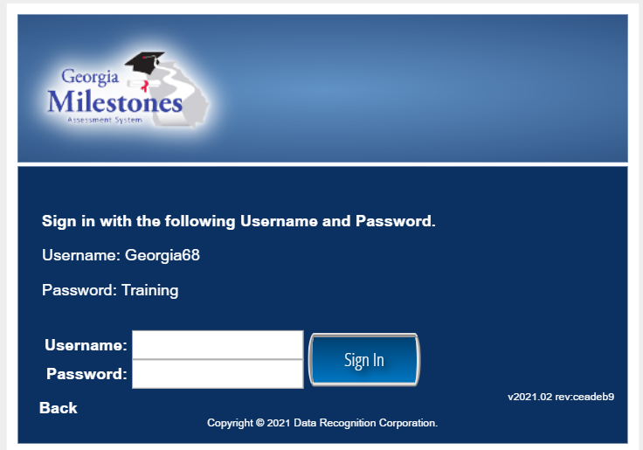
Getting Ready for GMAS
1. Log on: http://www.gaexperienceonline.com/
Click Test Practice
Under EOG, Click Online Training Tool
Click EOG Test Practice
Click Standard Online Tools
Click Grades 3-5, 6-8, 9-12
Username: Georgia-- Password: Training

Slide 3
What changes have occurred on the GMAS?
Replaced all constructed response items in Math to technology-enhanced
Replaced some constructed response items in ELA to technology enhanced
Reduced the total number of points in Science and Social Studies
Eliminated Norm-referenced items in all grades
Section 1 of the ELA (Narrative Writing and Reading and Evidenced-based writing) did not change, but Sections 2 & 3 (which assess reading comprehension) replaced by technology enhanced items
Reduced the amount of testing by 30 minutes in ELA
Reduced the amount of testing by 40 minutes in Science and Social Studies
Grades 3-8 will all take ELA and Math
Only grades 5 and 8 will take Science
Only 8th grade will take Social Studies

Slide 4
TECHNOLOGY ENHANCED vs Constructed Response
A Technology-Enhanced Item is a computer-delivered item that includes specialized interactions for collecting response data. These include interactions and responses beyond traditional selected-response or constructed-response.
Technology Enhanced Items have been specifically designed to encourage students to construct an answer as opposed to merely selecting a response. They require students to think critically, and thus, they gain a better understanding of a student’s depth of understanding and knowledge of a particular topic.

Slide 5
Advantages of Technology-Enhanced Items
TEIs can be used to assess learners’ high-level thinking skills and problem-solving abilities
Including TEIs in assessments can resemble real-world scenarios in which learners might interact with content and information using technology
Technology-Enhanced Items provide a more authentic and engaging experience for learners
Educators are more informed about the thinking process and how the student has formulated their response
Technology-Enhanced Items are computer-scorable, meaning data is gathered in the simplest way

Slide 6
Types of Technology-Enhanced Items
Complex math formulas
Visual questions (Including hotspot, shading, fill, file upload)
Graphing
Drag & Drop (Text, image, classification)
Fill in the blanks (Text, dropdown, image)
Charts (Bar chart, line chart, histogram, dot plot, line plot)
Match & order (Match, sort, order buttons/paragraphs/words & sentences)

Slide 7
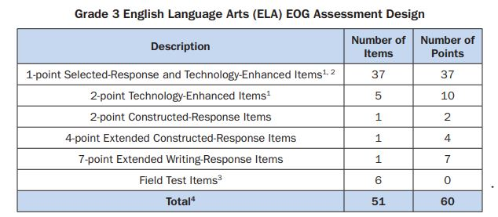
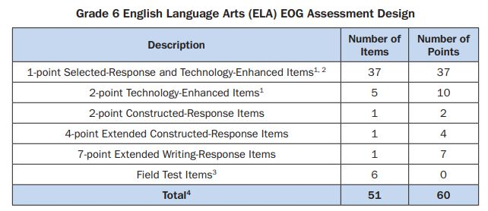
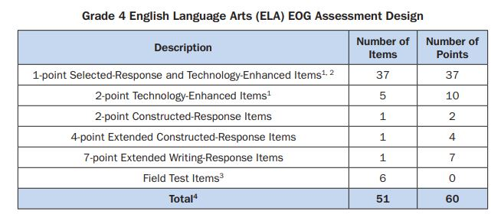
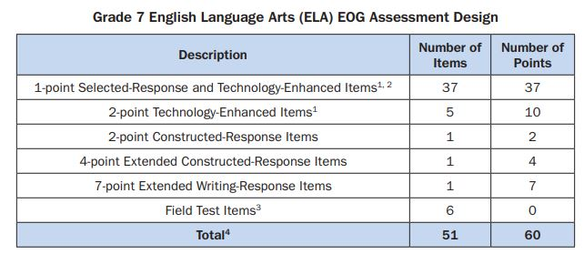
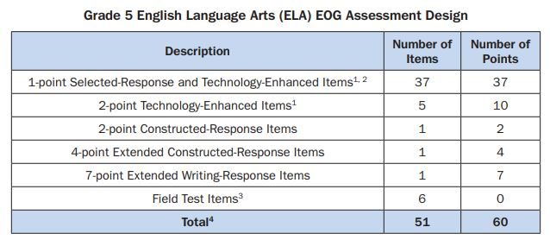
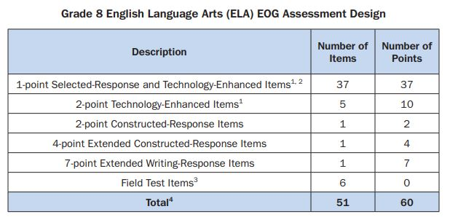
Assessment Design
37-1pt Selected Response - 37pts
5- 2pt Technology Enhanced-10 pts
1- 2pt Constructed Response - 2pts
1- 4pt Extended Constr. Response- 4pts
1- 7pt Extended Writing Response – 7pts

Slide 8
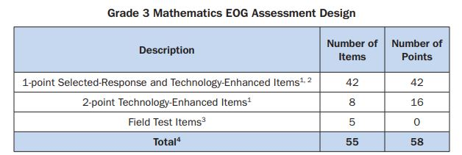
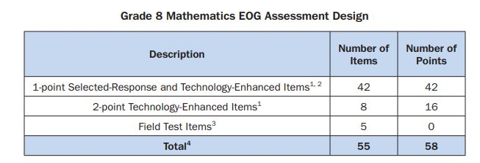
Assessment Design
**Grades 3 -8 are the same
2 Technology-Enhanced Response items (2 pts each) 42 Selected-Response and Technology Enhanced Items
Make sure your students are familiar with the Technology-Enhanced Item!

Slide 9
All Content Areas - Model, think aloud and practice with students
Read Two Selections from a Variety of Genres/Modes…...
Main Idea, Central Theme/s
Sequence, Summarize, Draw Conclusions
Strengths and Weaknesses
Cite Specific Evidence, Quote
Compare and Contrast
Cause and Effect
Similarities and Differences
Author’s Point of View - loaded language; include/avoid facts
Fact and Opinion, Reasoned Judgment
Argue For and Against , Claim w/ reasons
Others: p. 29 6-8 Literacy Standards for SS/Sci/TS

Slide 10
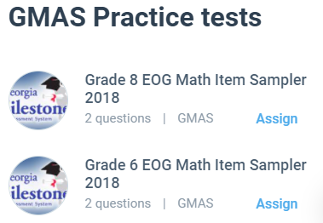
Free Website
EDULASTIC

Slide 11
Free Website
Lumous Learning 2nd – HS ELA & Math
**Technology Enhanced Questions

Slide 12
Questions?

Slide 13
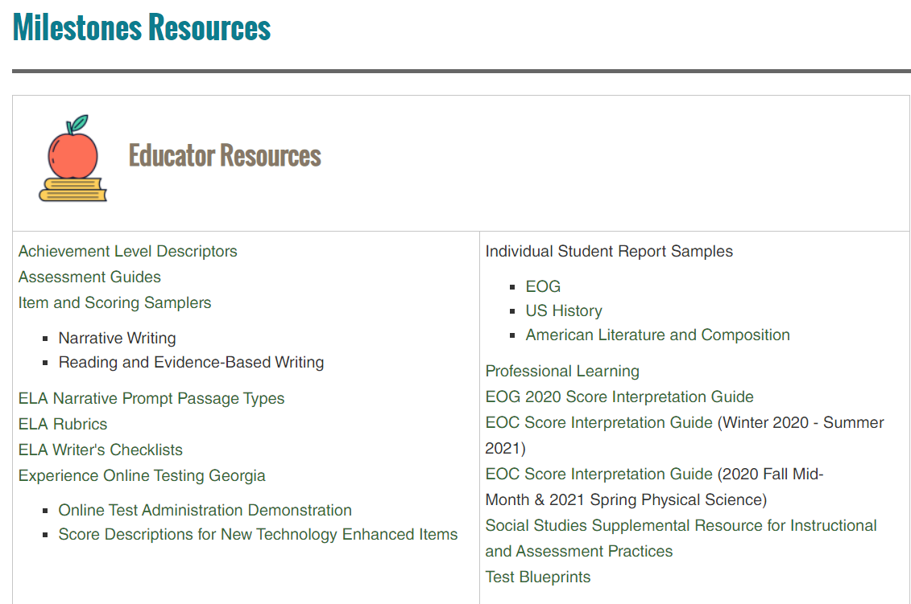
Teacher GMA EOC Resources
How do I know what to plan for when students are below grade level?
K-5 ELA Progressions for Quick Reference
K-8 Math Progressions GSE

Slide 14
What Did You Discover? What “ah ha” did you have? What resonated with you? Type your response in the chat box and be prepared to share orally.

