Slide 1
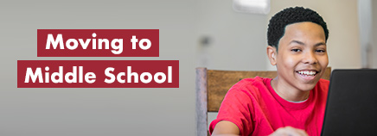
Make A Smooth Transition:
Preparing Your Child for Middle School Success

Slide 2

Prepare For New Academic Challenges
Expect a lot from your child
Stay positive
Ask about school everyday
Help your child learn to manage time
Learn to manage changing classes
Teach your child good organizational skills
Get a planner

Slide 3

What Parents Can Do To Help With Middle School Success:
Make sure you have an Infinite Campus Login to check your child’s grades and attendance.
Stay in contact with the school.
Get to know the counselor and parent liaison.
Attend parent meetings.
Know what is going on with your child academically.
Be familiar with high school requirements.
Be involved with your child’s education.
Have regular discussions with your child about their future.

Slide 4

Parents, if you don’t have access to your kids grades online for Infinite Campus, you can now create your own account. You can check grades for each class, check attendance, and more.
You can get notifications every time grades are entered by the teacher. This will allow you to keep up with what assignments are completed or what assignments are late.
There is an Infinite Campus App to check grades on your phone. The app is called Campus Portal and looks like the picture above. It is available on Apple and Android phones. You will have access to grades right at your fingertips.
Also, your students can download the student app to teach them responsibility in keeping up with their own assignments and grades.

Slide 5

Talk about the move: It’s a New Environment!
Take a tour of the school
Meet his/her teachers, if possible
Review the route to school or the bus stop
Go over the school handbook

Slide 6

Elementary Vs. Middle School
Elementary
Most elementary 5th grade classes are self contained with a few changing classes 2-3 times per day.
Classwork and projects are easier to manage.
Elementary students may or may not have homework every night.
Personal belongings are kept in the classroom.
Middle School
Middle school students change classes 6-7 times per day.
Classwork and projects take more effort to manage because of having multiple classes/teachers.
Schoolwork is more challenging.
Middle school students have more homework to manage from multiple teachers.
Personal belongings are kept in lockers. Students have an allotted amount of time between classes.
Different middle schools have different requirements for what types of bookbags that are allowed.

Slide 7
Elementary Vs. Middle School
Elementary
Students in grades 3-5 take the Georgia Milestones (GMAS). All students in grades 3-5 take the Reading and Math assessments, but 5th grade students will also take the Science and Social Studies assessments.
Elementary students take P.E. three times a week.
Middle School
Students in grades 6-8 take Georgia Milestones (GMAS). All students in grades 6-8 take the Reading and Math assessments, but 8th grade students will also take the Science and Social Studies assessments. Algebra I students will take the End of Course test for GMAS.
Middle school students take P.E. every day and must dress out.

Slide 8
Make sure they are ready!
Read and comprehend nonfiction, fiction, dramas, and poems
Write and revise research and reflection papers
Meaning of unknown and multiple-meaning words and phrases
Figurative language, word relationships, and nuances in word meanings
Ratio concepts and using ratio reasoning to solve problems
Computing multi-digit numbers and finding common factors and multiples
Applying math to algebraic expressions
Solving one-variable equations and inequalities
Reading and comprehending science/technical text according to grade level
Reading and comprehending history/social studies text according to grade level

Slide 9
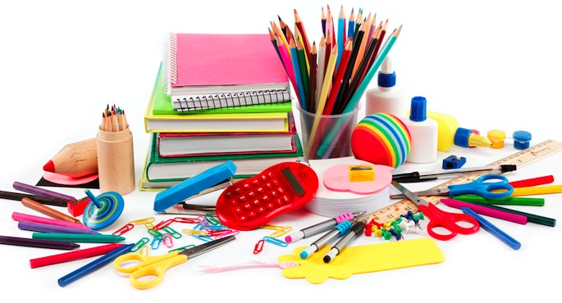

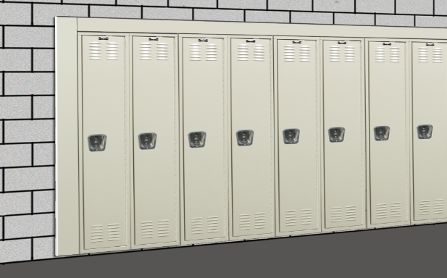
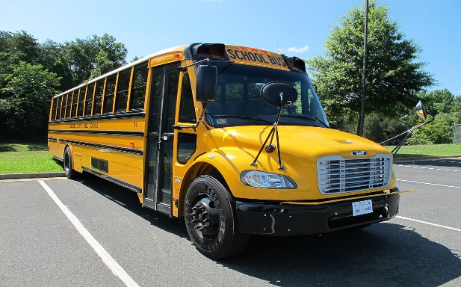
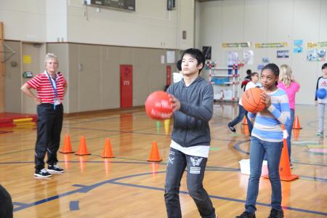
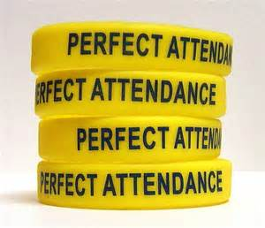


Things To
Think About
Supplies
Locker
Gym
Clubs
Cell Phones
Travel
Attendance
Sports

Slide 10

Learn about policies and procedures
Conduct
Dress Code
Check-In/Check-Out
Additional school specific requirements

Slide 11

New Routines
Different People
More Challenging Academics
Changing body, mind, and sense of self
Changing Friendships

Slide 12
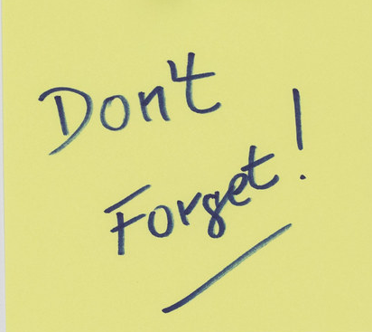
Parents,
Don’t forget to do your online registration!

Slide 13

Thank you for your support! If you have questions, you can reach out to the middle school in which your child is assigned for the 2023-2024 school year.
Thank you parents!!

